Slide 1
Data Mining Overview and Predictive Modeling
DSBA/MBAD 6211 Advanced Business Analytics
Spring 2024/2020

Slide 2
Agenda
Data Mining Process Overview
Predictive Modeling
Model Comparison and Evaluation

Slide 3
What Is Data Mining?
Data mining is the discovery of models from data.
Data contains value and knowledge.
Various types of models
Statistical modeling
Machine learning
Beyond counts, descriptive techniques, and reporting
Notes:
Data mining is a process of extracting and discovering models/patterns in large data sets involving methods at the intersection of machine learning, statistics, and database systems
Scour large databases in order to find novel and useful patterns that may otherwise remain unknown.
No all-information discovery tasks are considered to be data mining: such as looking up individual records using a database management system
Cannot directly observe from dataset: Data mining uses machine learning and statistical models to uncover clandestine or hidden patterns in a large volume of data

Slide 4
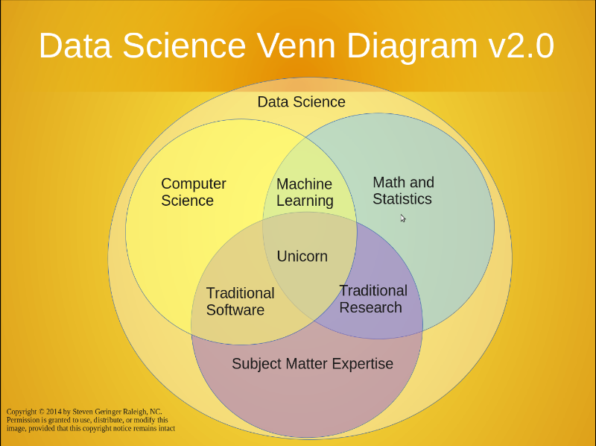
Origins of Data Mining
Data mining is a discipline lying at the interface of mathematics/statistics, computer science, and domain expertise
Challenges
Scalability
Dimensionality
Heterogeneity
Ownership and distribution
Adopt from Grossman, R.L., Kamath, C., Kegelmeyer, P., Kumar, V., Namburu, R. Data Mining for Scientific and Engineering Applications
Notes:
Interdisplinary; stands at the confluence of the fields of statistics and machine learning
1. Origins – discover in database 1980s.
2. What driven the development? Motivating challenges?
Scalability
High Dimensionality (hundreds or thousands of attributes) e.g., in bioinformatics, gene expression data involving thousands of features
Heterogeneous and complex data: continuous, categorical, semi-structured
Data ownership and distribution : reduce the amount of communication needed; how to effectively consolidate the data from multiple sources; how to address data security and privacy issues
Non-traditional Analysis: A hypothesize-and-test paradigm. In other words, a hypothesis is proposed, an experiment is designed to gather the data, and then the data is analyzed with respect to the hypothesis. Labor-intensive and time consuming
Generation and evaluation of thousands of hypotheses
Not a result of a carefully designed experiment

Slide 5
What Is Data Mining?
Supervised learning (with responses or dependent variables)
regression
decision trees
neural network
Unsupervised learning (without responses or dependent variables)
cluster analysis
association rules
Reinforcement learning
Figure out What to do to maximize a Reward by itself
Does not strictly rely on set of labeled dependent variables
Examples
Markov decision process
Q learning
Notes:
Reinforcement learning: It is about learning the optimal behavior in an environment to obtain maximum reward

Slide 6
Data Mining Tasks
Prediction
Predict dependent variables based on independent variables
Little focus on mechanism
Example: which customers are most likely to purchase?
Inference
Understand the relationship between dependent variables and independent variables
Are they associated?
What is the relationship?
Example: what kind of products customs like to buy together?
Notes:
Prediction methods Examples:
which loan applicants are likely to default? (we can use classification techniques to identify them)
Which costumers are most likely to commit, for example, fraud?
Description methods Examples:
Association rules: customer transactions “what goes with what”. Grocery stores can use such information after a customer’s purchases have all been scanned to print discount coupons, by mapping customers’ purchase onto the association rules.
Clustering: market segmentation: customers are segmented based on demographic and transaction history information, and a marketing strategy is tailored for each segment.
Clustering: market structure analysis: identifying groups of similar products according to competitive measure of similarity.

Slide 7
Pattern Detection
Patterns may or may not represent any underlying rule.
Some patterns reflect some underlying reality.
The party that holds the White House tends to lose seats in Congress during off-year elections.
Others do not.
When the American League wins the World Series in Major League Baseball, Republicans take the White House.
Sometimes, it is difficult to tell without analysis.
In U.S. presidential contests, the taller candidate usually wins.
Notes:
Since at least the mid-1800s, the party that controls the White House has typically lost seats in Congress in the midterm elections.
“The size of the loss correlated, to varying degrees, with the disappointment with the president and the president’s party, the state of the economy, the ebb and flow of turnout for the two parties, as well as occasional scandals or crises,” said Steven S. Smith, a political scientist at Washington University in St. Louis.
Political scientists call this the “thermostatic” effect — voters adjust how they vote, as they would a home thermostat. The common pattern of voters from the opposition party being more energized to vote is closely related; it stems from anger serving as a stronger motivator to vote than contentment.

Slide 8
What Types of Patterns Are Valuable?
Evidence
Use a statistical criterion to measure the significance of the finding
Redundancy
Similarity to other findings
Usefulness
Meet the goal of the user
Simplicity
Generality
“Data analysis is as much an art as a science.”

Slide 9
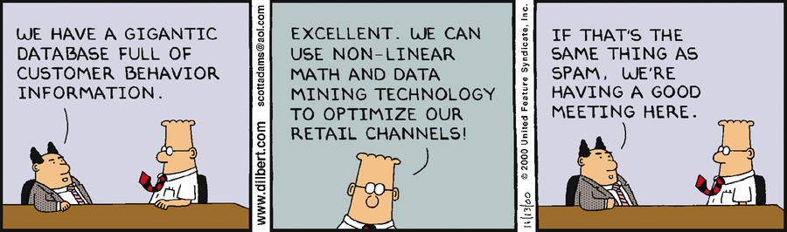
What Types of Patterns Are Valuable?

Slide 10
What Types of Patterns Are Valuable?
Bonferroni’s Principle
Roughly speaking, a data-mining risk is that you “discover” patterns that are meaningless
If you look in more places for interesting patterns than your amount of data will support, you are bound to find crap
What your model suggests >>what you should expect
“Torture the data, and it will confess to anything.” Ronald Coase, Economics Nobel Prize Laureate

Slide 11
Bonferroni’s Principle: An Example
Terrorist detection
Potential rule: two unrelated people who at least twice have stayed at the same hotel on the same day
Expected number of “suspicious” pair of people
10⁹ people being tracked
1,000 days
Each person stays in a hotel 1% of time (1 day out of 100)
Hotels hold 100 people (so 10⁵ hotels)
If everyone behaves randomly
Finding: 250,000 “suspicious” pairs
Notes:
https://rationalwiki.org/wiki/Bonferroni%27s_principle
The Bonferroni Principle¹ is a statistical method for accounting for these random events.
Even in completely random datasets, you can expect particular events of interest to occur, and to occur in increasing numbers as the amount of data grows.

Slide 12
Bonferroni’s Principle: An Example
Your model suggests: 250,000 “suspicious” pairs
Suppose the reality is that only 10 pairs of evil-doers stayed at the same hotel twice in the past 1000 days
What your model suggests >>what you should expect
Useless model
Very expensive to find 10 real cases through 250,000 candidates

Slide 13
Bonferroni’s Principle
When looking for a property (e.g., “two people stayed at the same hotel twice”), make sure that the property does not allow so many possibilities that random data will surely produce facts of interest.

Slide 14
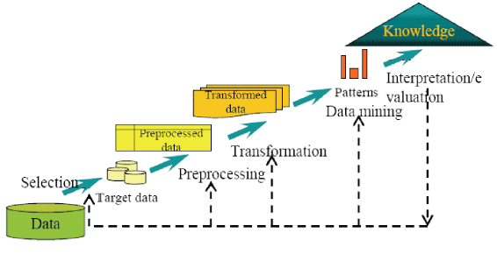
Data Mining Process
How do we get from Data to “knowledge ”
Adopt from Grossman, R.L., Kamath, C., Kegelmeyer, P., Kumar, V., Namburu, R. Data Mining for Scientific and Engineering Applications

Slide 15
Data Mining Process
Define Purpose
Obtain Data
Explore & Clean Data
Determine Date Mining Task (classification, clustering, etc.)
Partition the Data (for supervised tasks)
Choose Data Mining Methods (regression, neural nets, etc.)
Apply Method
Evaluation Performance
Model Deployment

Slide 16
Case Background
A financial services company offers a home equity line of credit to its clients. The company has extended several thousand lines of credit in the past, and many of these accepted applicants (approximately 20%) have defaulted on their loans. By using geographic, demographic, and financial variables, the company wants to build a model to predict whether an applicant will default.

Slide 17
1. Define Purpose
What is the purpose of the project?
The goal of the project is “to predict whether an applicant will default”
Questions to think:
How will the stakeholder use the results?
Who will be affected by the results?
Will the analysis be a one-shot effort or an ongoing procedure?
Notes:
Why this purpose:
An individual’s annual income results from various factors. Intuitively, it is influenced by the individual’s education level, age, gender, occupation, and etc.
Salary class is important,

Slide 18
2. Obtaining Data
May include sampling from one or more databases
Sampling is the main technique employed for data selection
Sampling is used in data mining because processing the entire set of data of interest is too expensive or time consuming
Notes:
Geographic information → urban or rural areas? ➔. Income level
Salary.cvs → not every one, 1% of the total population

Slide 19
Variable Description
Name | Model Role | Measurement Level | Description
BAD | Target | Binary | 1: default
CLAGE | Input | Interval | Age of oldest credit line in months
CLNO | Input | Interval | Number of credit lines
DEBTING | Input | Interval | Debt-to-income ratio
DELINQ | Input | Interval | Number of delinquent credit lines
DEROG | Input | Interval | Number of major derogatory reports
JOB | Input | Nominal | Occupational categories
LOAN | Input | Interval | Amount of the loan request
MORTDUE | Input | Interval | Amount due on existing mortgage
NINQ | Input | Interval | Number of recent credit inquiries
REASON | Input | Binary | DebtCon=debt consolidation. HomeImp=home improvement
VALUE | Input | Interval | Value of current property
YOJ | Input | Interval | Years at present job

Slide 20
3. Explore, Clean, and Preprocess
Data problems
Missing values
Outliers
Errors
Understand your data
Data type for each variable – correct?
Data range – reasonable?
Visualization – any model-free patterns?
Exploring, understanding and visualizing data are perhaps the most important steps in the data mining process
Notes:
Should first learn the data.
Data problems: dirty data, missing values, outliers
If not, researchers may end up drawing an inaccurate inference.
Visualization and summary statistics are two best ways to understand your data as well as detect any potential problems
R. application: ggplot2, Summary (), str(), glimpse()
Are there missing values? If yes, how should we handle them?
Are there outliers? How should we handle them?
How to handle categorical variables?
Are the data summaries what we would expect? Are the ranges of values reasonable?
What does the data look like? Visualization the data using graphing techniques

Slide 21
Manage Missing Values
Causes
Errors
Non-applicable measurement
Non-disclosed measurement
Regression & Neural Network models
Ignore incomplete observations
Decision tree
Automatically handle missing values with a variety of algorithms
Notes:
Missing value:
1.Imputation
2.Omission
3.Analysis
Transform variables: when data already clean, we still need to
Highly skewed variable: → log transfer (normality, make the pattern more visible)
High scale, low scale, high scale data the → normalized
Problems in data → wrong decision making
1. Transfer→ normal distribution good property
Log transfer

Slide 22
Manage Missing Values
Problems?
A smattering of missing values can cause an enormous loss of data in high dimensions.
Assuming that each of the k input variables is missing at random with probability α. In this situation, the expected proportion of complete cases is as follows:
A 1% probability of missing (α=.01) for 100 inputs leaves only 37% of the data for analysis, 200 leaves 13%, and 400 leaves 2%.
inputs
target
Notes:
In Python: åprint(0.99 ** 100)
V1 99%
V2 99%
…
V100 99%
99% ^ 100 =

Slide 23
Manage Missing Values
Synthetic distribution methods
Use a one-size-fits-all approach to handle missing values. Any case with a missing impute measurement has the missing value replaced with a fixed number.
Estimation methods
Provide customized imputations for each case with missing values. This is done by viewing the missing value problem as a prediction problem. That is, you can train a model to predict an input’s value from other inputs.
Notes:
Do we want to impute for the variable that have a relatively large percentage of missing values? For instance, 50%?

Slide 24
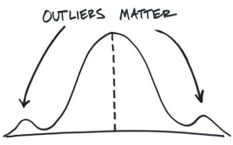
What Are Outliers
Definition: in statistics, an outlier is an observation that is numerically distant from the rest of the data.
A review of outliers is needed to determine if the data point is a result of an error or if it is a special case?
Bad data : age - 150
Data variation
Inspection:
Summary statistics
Visualization
Ways to handle
Error – manual correction
Small amount-treat as missing values
https://www.alexandergroup.com/insights/the-other-side-of-outliers/
Notes:
An outlier may indicate bad data. For example, the data may have been coded incorrectly or an experiment may not have been run correctly. If it can be determined that an outlying point is in fact erroneous, then the outlying value should be deleted from the analysis (or corrected if possible).
2. In some cases, it may not be possible to determine if an outlying point is bad data. Outliers may be due to random variation or may indicate something scientifically interesting. In any event, we typically do not want to simply delete the outlying observation. However, if the data contains significant outliers, we may need to consider the use of robust statistical techniques.

Slide 25
Variable Transformation
Independent variables with highly skewed distributions
A small percentage of the points may have a great deal of influence.
Transforming or regularizing variables
true association
standard regression
standard regression
true association
skewed input
distribution
high leverage points

Slide 26
Categorical Variables and Dummy Coding
Categorical variables
Variables that can take on one of a limited, number of possible values
Examples:
Student: Yes/No (binary/dichotomous)
Size: Small, Medium, Large, & Extra Large
Dummy coding
Uses only ones and zeros to convey all of the necessary information on categories
k categories with k-1 coded variables

Slide 27
Categorical Variables and Dummy Coding
Redundant
Level
D_{I}
D_{A} D_{B} D_{C} D_{D} D_{E} D_{F} D_{G} D_{H}
D_{I}
A
0
1 0 0 0 0 0 0 0
0
B
0
0 1 0 0 0 0 0 0
0
C
0
0 0 1 0 0 0 0 0
0
D
0
0 0 0 1 0 0 0 0
0
E
0
0 0 0 0 1 0 0 0
0
F
0
0 0 0 0 0 1 0 0
0
G
0
0 0 0 0 0 0 1 0
0
H
0
0 0 0 0 0 0 0 1
0
I
0 0 0 0 0 0 0 0
1
1
Notes:
9 levels

Slide 28
Variable Selection
Some variables will not enter the model
Can not use
Legal consideration
Privacy/ethical issues
Should not use
Significant quality issues
Constant
Conceptually nonrelated
Redundant information

Slide 29
5.Data Partition (for supervised task)
Validation
Training
Test

Slide 30
Data Partition
Improving the model causes the error rate to decline on the data used to build it. At the same time, the model becomes more complex.
Error Rate
Models Getting More Complex

Slide 31
Validation Data Prevents Overfitting
Sweet spot
Error Rate
Signal
Validation Data
Noise
Training Data
Models Getting More Complex

Slide 32
Data Partition
Mutually exclusive data sets
Use the training set to find patterns and create an initial set of candidate models.
Use the validation set to select the best model from the candidate set of models.
Use the test set to measure performance of the selected model on unseen data.
Holdout sample
Training
Validation
Test

Slide 33
Data Partition
Trade-off
More data is devoted to training results in more stable predictive models, but less stable model assessments (and vice versa).
Also, the test partition is used only for calculating fit statistics after the modeling and model selection is complete.

Slide 34
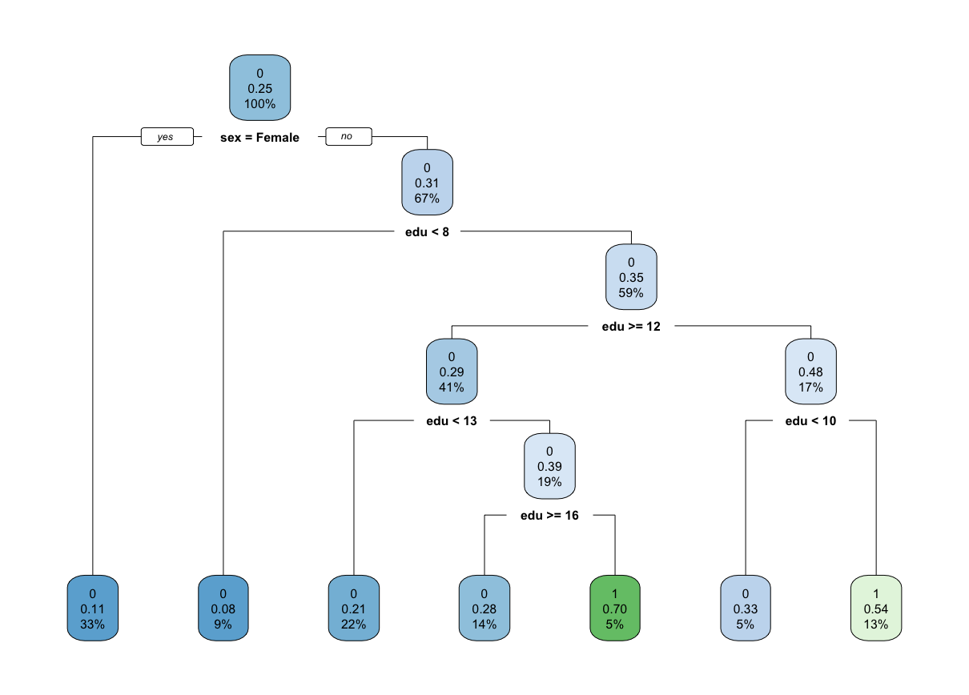
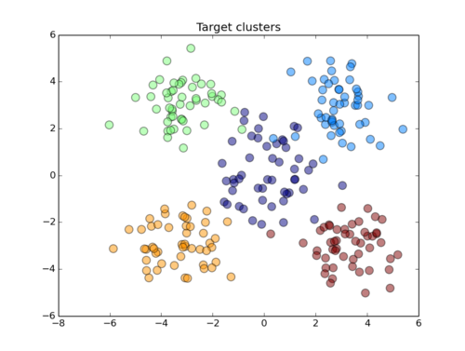
6. Choose Data Mining Methods
Model selection referrers both to selecting the “right” model using a method and to selecting between methods.
There is no universal best method!
Notes:
Characteristics of the data:
Models to predict category: classification
Models to predict numeric: regression trees
Models to improve prediction : boosting, Bagging
Modles to drive insights: clustering, association rules, etc…
Performance: performance metric

Slide 35
Model Selection
Model selection is dependent on both the data at hand and the data mining goal
Key considerations:
Accuracy
Interpretability
Ease of modeling
Robustness of model
The ease of handling missing values
Notes:
Accuracy: the percentage of observations that are correctly classified

Slide 36
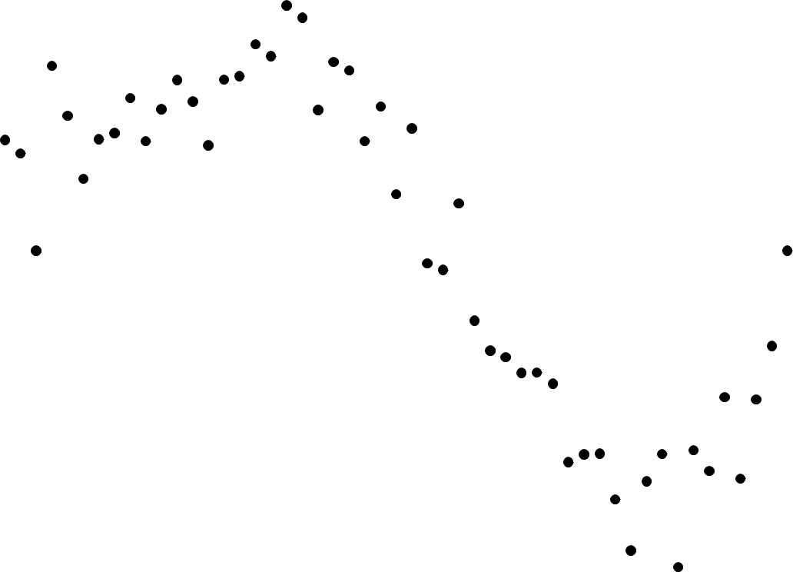
Model Comparison

Slide 37
Model Comparison
Too flexible

Slide 38
Model Comparison
Too flexible
Not flexible enough

Slide 39
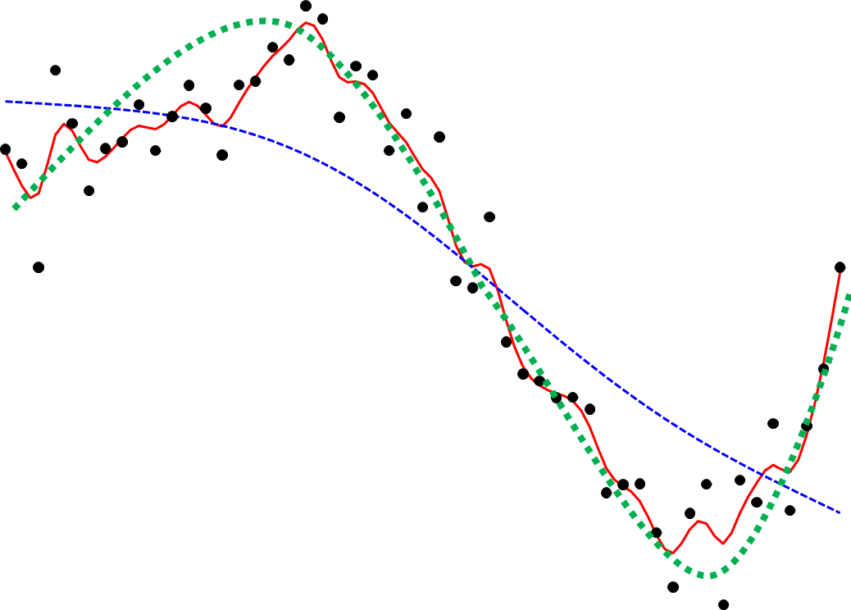
Model Comparison
Just right
Too flexible
Not flexible enough

Slide 40
8. Model Evaluation
The goal is to accurately predicting some outcomes
In the context of sales forecasting, where we want to develop a model that best predicts future sales
It may be interesting and lead to key insights to think about variables that drive sales, for the purpose of best matching stock with demand we may only want to know future sales with as much accuracy as possible
We would like prediction measures that reflect our goal, and give us information about the prediction accuracy

Slide 41
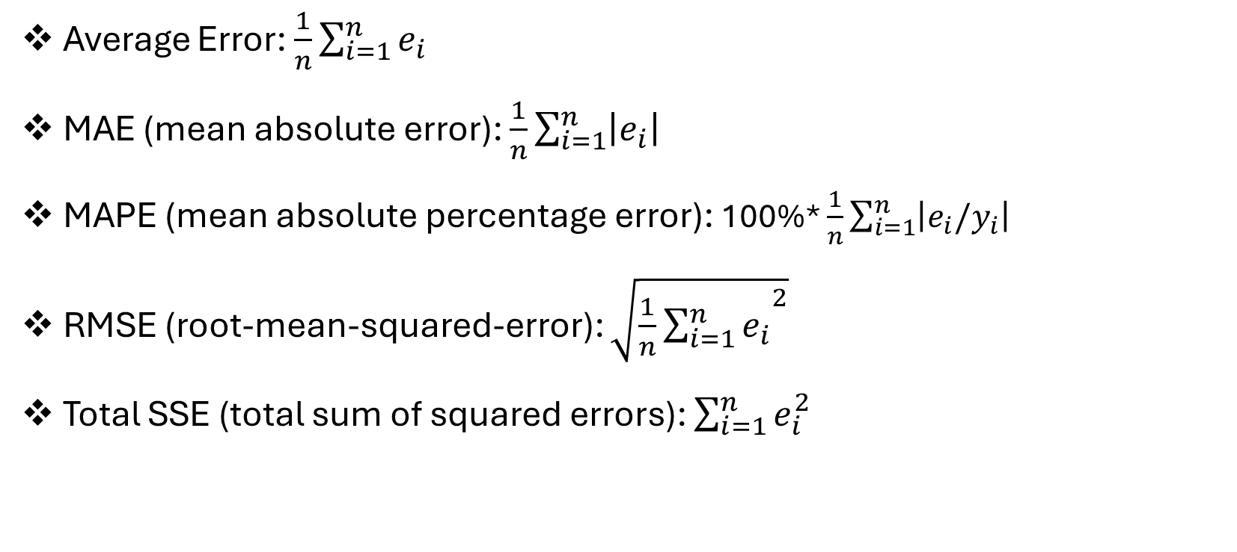
Regression Evaluation
Average Error: $\frac{1}{n}\sum_{i=1}^{n}{e_{i}}$
MAE (mean absolute error): $\frac{1}{n}\sum_{i=1}^{n}{\left|e_{i}\right|}$
MAPE (mean absolute percentage error): 100%* $\frac{1}{n}\sum_{i=1}^{n}{\left|e_{i}/y_{i}\right|}$
RMSE (root-mean-squared-error): $\sqrt{{\frac{1}{n}\sum_{i=1}^{n}{e_{i}}}^{2}}$
Total SSE (total sum of squared errors): $\sum_{i=1}^{n}{e_{i}^{2}}$
Notes:
Regression: forecasting sales; predict price
the RMSE gives a relatively high weight to large errors. This means the RMSE should be more useful when large errors are particularly undesirable.

Slide 42
Model Evaluation— Categorical Outcomes
 |  | Observed
 |  | True | False
Predicted | True | True positive | False positive (Type I error) | Precision = True positive/Predicted positive
 | False | False negative (Type II error) | True negative | Negative predictive value = True negative/Predicted negative
 |  | Sensitivity = True positive/Actual positive | Specificity = True negative/Actual negative | Accuracy=No. of correct decisions/All cases

Slide 43
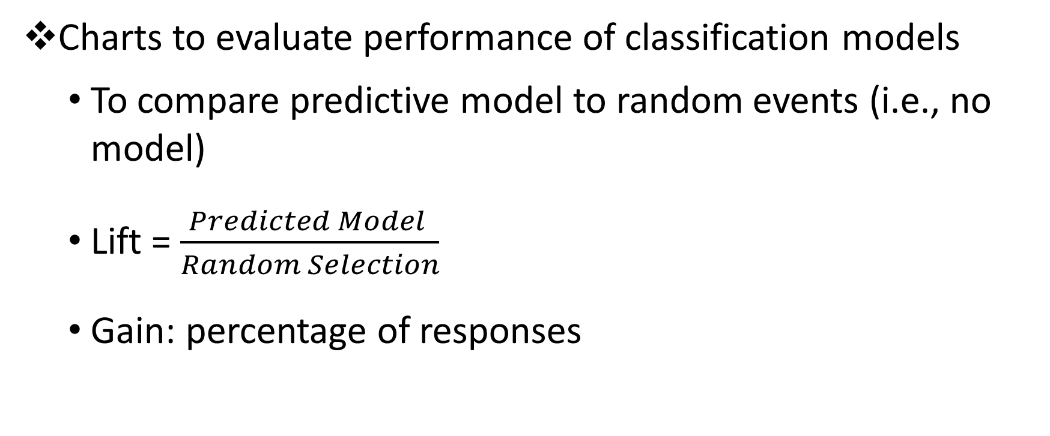
Lift and Gain Charts
Charts to evaluate performance of classification models
To compare predictive model to random events (i.e., no model)
Lift = $\frac{Predicted Model }{Random Selection}$
Gain: percentage of responses
Notes:
Gain: can we capture responses early on.

Slide 44
Lift and Gain Charts: Example
Based on a predictive modeling, rank customers from most likely to response to least likely to response
An email campaign with 20% average response rate
Total customer contacted | Responses
1000 | 200
Total customer contacted | Responses
100 | 60
200 | 100
300 | 130
400 | 158
500 | 170
600 | 180
700 | 188
800 | 194
900 | 198
1000 | 200
Notes:
Use email wisely=> may annoy people
Model will not change consumer behaviors (we will still have 200 Reponses)

Slide 45
Lift and Gain Charts: Example
Total customer contacted | Model Responses | Random Selection | Cumulative Lift | Gain
100 | 60 | 20 | =60/20 = 3 | =60/200 =
200 | 100 | 40 | = 100/40 = 2.5 | = 100/200 = 50%
300 | 130 | 60
400 | 158 | 80
500 | 170 | 100
600 | 180 | 120
700 | 188 | 140
800 | 194 | 160
900 | 198 | 180
1000 | 200 | 200
Notes:
60/200 = 30%
100/200 = 50%

Slide 46
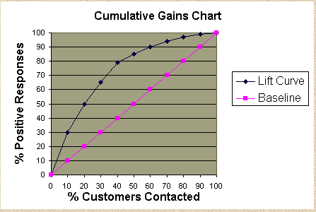
Gain Chart
X-axis: percentage of customers contacted
Y-axis: percentage of responses
Baseline: random selection
Lift curve: predicted model

Slide 47
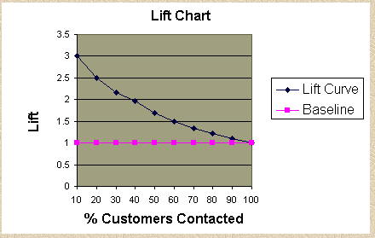
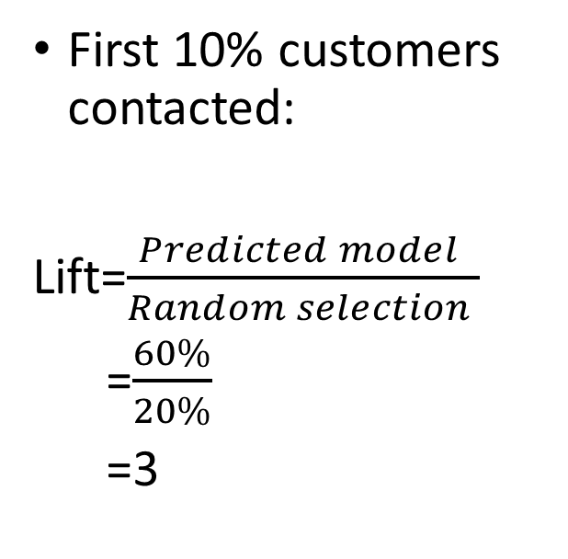
Lift Chart
First 10% customers contacted:
Lift=$\frac{Predicted model }{Random selection }$
=$\frac{60\%}{20\%}$
=3

